Slide 1
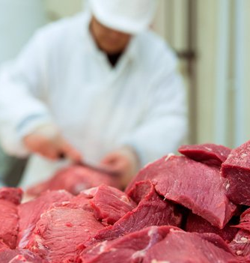

Survey of Small to Mid-sized Colorado Meat Processors: Preliminary Summary & Research Results
Miles Rollison
Daniel Mooney
Agricultural and Resource Economics
Colorado State University
Martha Sullins
Food Systems & Business Management Extension
Colorado State University
Food Systems
Lab
Oct. 12, 2018

Slide 2

Motivation
Livestock supply chains built around growing consumer demand for differentiated meat products present small to mid-sized producers with new direct marketing and value-added options to manage risk and enhance economic viability. A critical factor affecting the possibilities to capitalize on these new market opportunities is the scalability and strength of connections along the livestock to meat products supply chain. This portion of our study focuses on barriers and opportunities in the harvesting and fabrication portion of the supply chain.
Producer
(Rancher)
Processor
(Slaughter)
Processor
(Fabrication)
Distribution,
Consumer,
Etc.

Slide 3
Presentation Outline
2017 Survey of Small to Mid-Sized Meat Processors
Summarize preliminary findings
“Determinants of Processor Commitments to Niche Meat Producers: Consideration and Volume”
Present preliminary empirical modeling and estimation results

Slide 4
Survey Summary
Processors source ‘raw material’ (animals or meat) from a variety of sources
Note: Regressions use 48 observations from 16 processors (3 scenarios per processor)
First set of summary slides only use 13 observations
 | N | Mean
Wild game (1=yes, 0=no) | 13 | 0.69
Livestock – Custom process (1=yes, 0=no) | 13 | 0.92
Livestock – Purchased (1=yes, 0=no) | 13 | 0.54
Sourced meat (1=yes, 0=no) | 13 | 0.69

Slide 5
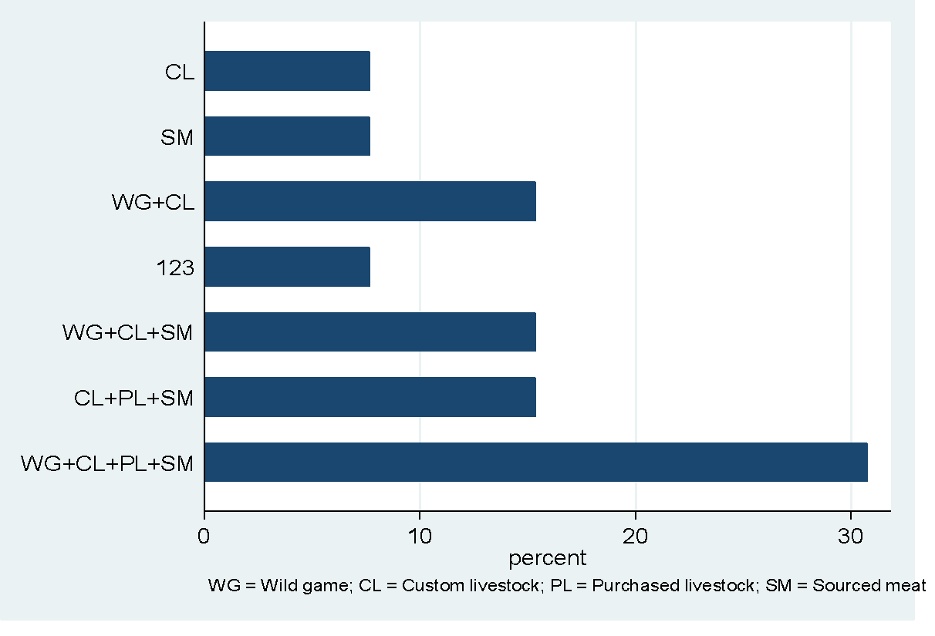
Survey Summary
Most processors are diversified in the sources they use, rather than specialized
Sources:
WG = Wild game
CL = Custom livestock
PL = Purchased livestock
SM = Sourced meat
Two-thirds obtain ‘raw materials’ from three or more sources
WG+CL+PP

Slide 6
Survey Summary – Annual Volume 2017
Smaller operations process in the hundreds
Larger operations process in the thousands
 | N | Mean | St Dev | Min | Max
Total animals | 11 | 1783 | 1257 | 316 | 4123
Wild game | 9 | 759 | 825 | 0 | 2500
Livestock | 11 | 1161 | 1024 | 149 | 3123
Livestock - Custom exempt | 9 | 931 | 677 | 213 | 2063
Livestock – USDA | 4 | 1100 | 1175 | 149 | 2769

Slide 7
Survey Summary – Other Factoids
Two-thirds operate at full capacity year-round
Average ‘days in advance’ to schedule livestock processing in busy season = 54 days
15% have plans to expand in 5 years
23% have plans to exit in 5 years
‘Increase profits’ and ‘Increase personal free time’ were the top two business goals

Slide 8
Transition to Empirical Research . . .
“Determinants of Processor Commitments to Niche Meat Livestock Producers: Consideration and Volume”
Goal: Gauge small to mid-sized processors’ willingness to enter into regular business agreements with livestock producers
Objectives: Identify key factors that influence:
(1) The probability of considering a new commitment
(2) The volume of their stated ‘ideal’ commitment

Slide 9
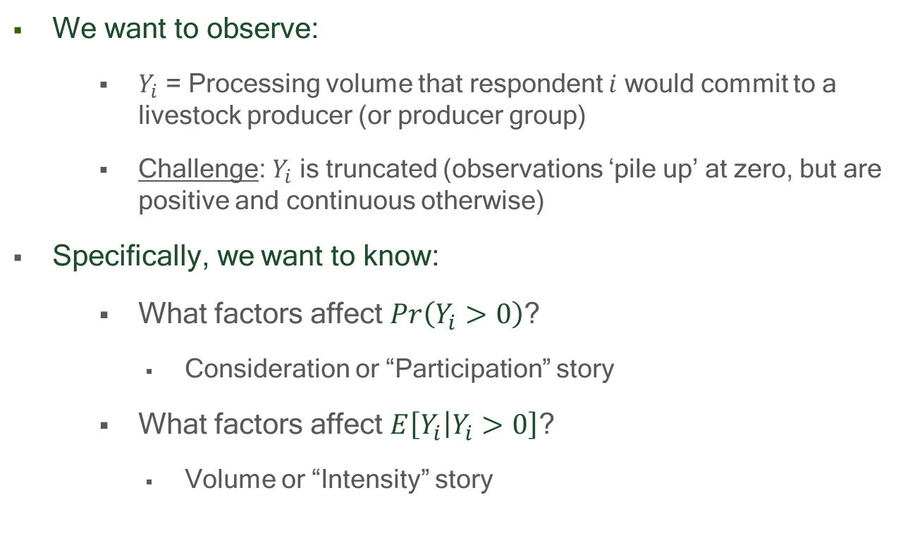
Empirical Strategy & Research Questions

Slide 10
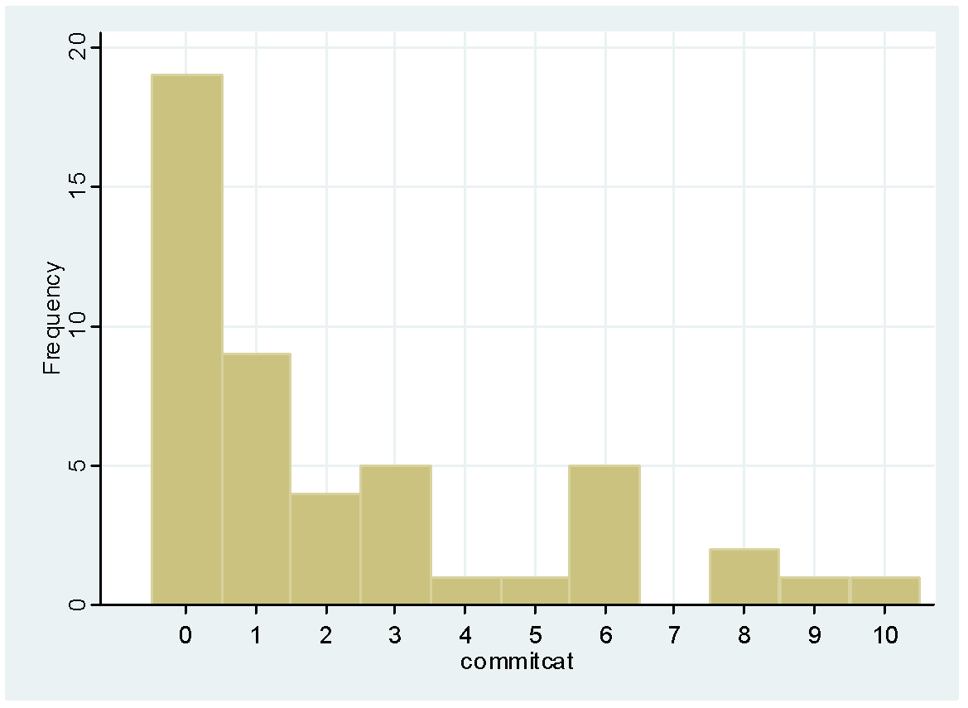
Stated Processing Volume Commitment (n = 48) Y_{i} = 0, Not consider (n=17) Y_{i} = 0, Inadequate terms (n = 2) Y_{i} > 0 (n = 29)
Survey Data - Empirical Distribution of Y_{i}
N = 19
40%
of
responses
0
1 - 399
400 - 799
. . . .
0
800
1600
2400
3200
> 4000
Processing Volume

Slide 11
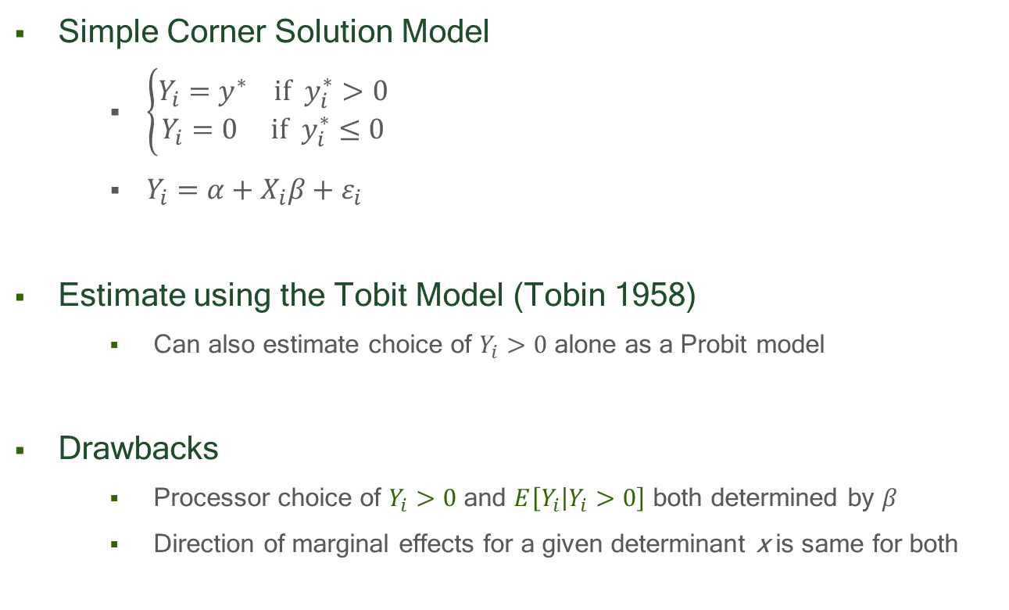
“Naïve” Conceptual Model

Slide 12
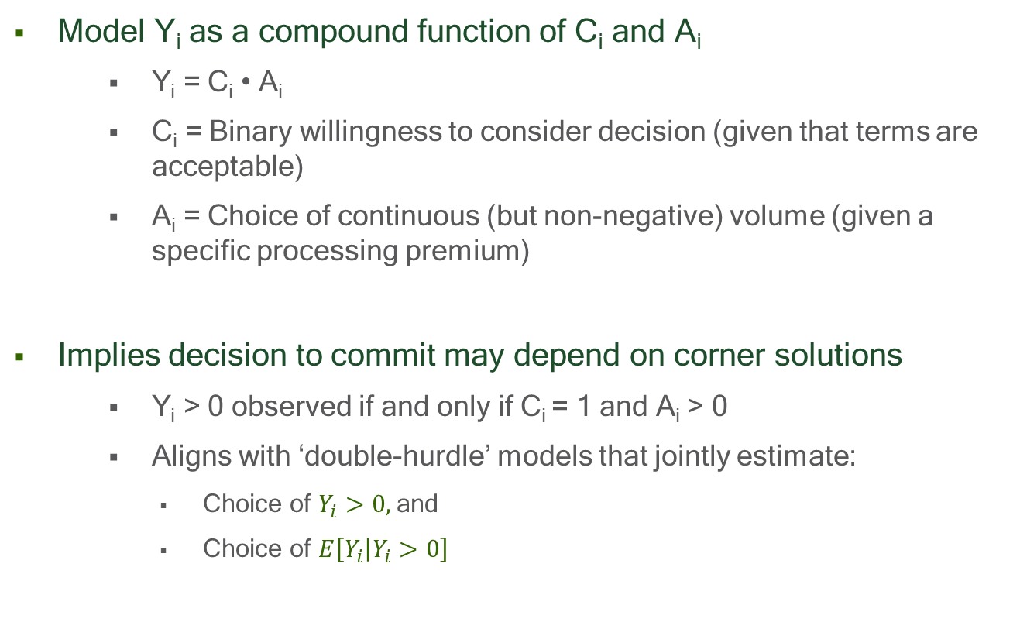
“Two-Stage” Conceptual Model

Slide 13
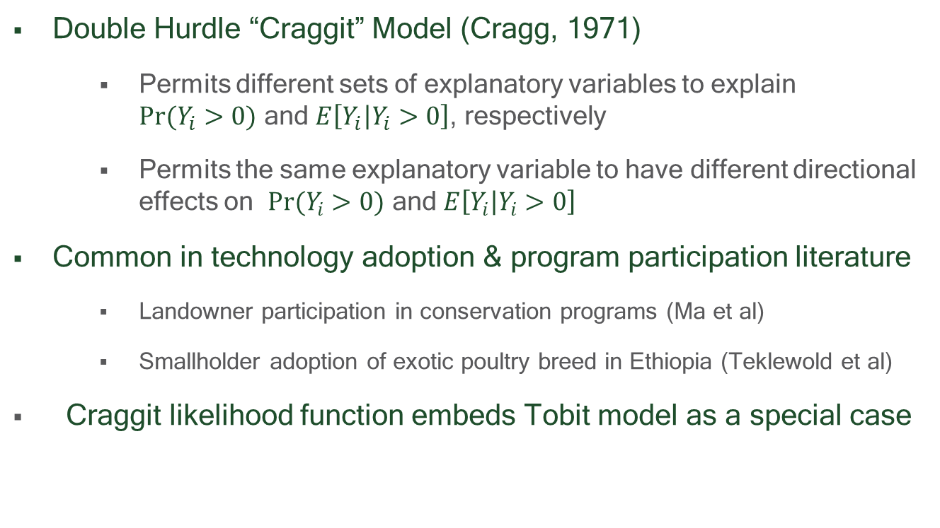
“Two-Stage” Estimation Strategy

Slide 14
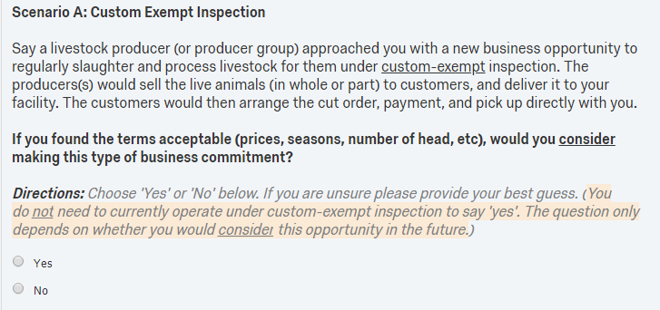
Elicit Stated ‘Consideration’ Decisions
Survey posed three hypothetical scenarios
Custom Exempt Inspection
USDA Inspection
Further processing of carcasses or boxed meat

Slide 15
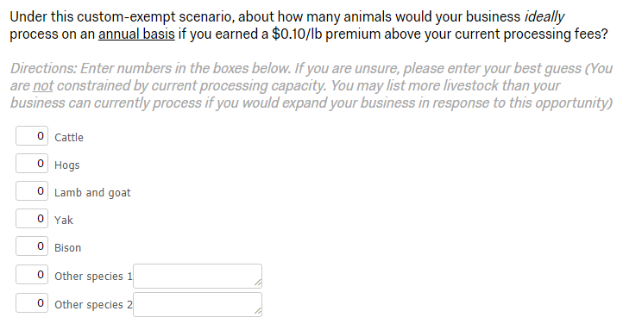
Elicit Stated ‘Volume’ Decisions
Assign a price premium at random
Premiums offered: $0.10/lb, $0.05/lb, none ($0.00)
Each respondent received one premium at random
Premiums constant across scenarios

Slide 16
Data – Explanatory Variables (n = 48)
Capacity = Processing volume capacity (Animals/Year)
Slaughter = Processor slaughters domestic livestock (Yes/No)
Specialized = Processor specialized in only one enterprises (Yes/No)
ScheduleLag = Demand for processing services (Days in advance a producer needs to schedule)
YearsOwned = Number of years processor has operated under current owners

Slide 17
Empirical Work in Progress
Improving survey reach
Increase sample size
Increase response rate
Empirical estimation
Probit models for the ‘Consideration’ decision (participation)
Tobit models for the ‘Commitment’ decision (intensity)
Craggit models for joint estimation of the ‘Consideration’ and ‘Commitment’ decisions
Test for difference in effects across 3 processing scenarios
Written summaries for stakeholder audiences

Slide 18
Prelim. Results – ‘Consideration Decision’
Whether processor slaughters livestock is most important variable
Quantified as binary dummy for custom exempt or USDA inspection
Probit results show it, but Craggit currently drops it from estimation
 | Model I: Probit |  |  | Model II: Craggit
Explanatory Variable | Coefficient Estimate | Standard Error |  | Coefficient Estimate | Standard Error
Specification 1 (Wald Chi-square: ***; LL = -24.33; n=48)
Slaughter | 1.126** | (0.498) |  | n.a. | n.a.
Specialized | —0.958* | (0.566) |  | n.a. | n.a.
Specification 2 (Wald Chi-squre: n.s.; LL = -192.2; n=26)
Capacity | < —0.001 | (< 0.001) |  | < —0.001 | (< 0.001)
ScheduleLag | —0.017 | (0.012) |  | 0.027 | (0.066)
Specialized | 0.068 | (1.920) |  | —1.476 | (484)
YearsOwned | 0.043 | (0.034) |  | —0.127 | (0.089)
Mfx’s
+42%
-37%

Slide 19
Prelim. Results – ‘Volume Commitment’
Tobit and Craggit results are qualitatively similar, but slightly different interpretations
Craggit model appears to improve efficiency, not yet conclusive
Need to sort out other estimation issues (e.g., s.e.’s & pooling)
 | Model I: Tobit |  |  | Model II: Craggit
Explanatory Variable | Coefficient Estimate | Standard Error |  | Coefficient Estimate | Standard Error
Specification 2 (Wald Chi-square: ***; LL = -211.50; n=26)
Capacity | 0.490*** | (0.143) |  | 0.541*** | (0.173)
ScheduleLag | -17.78** | (8.29) |  | -73.16*** | (22.21)
Specialized | 2294 | (1586) |  | 9853** | (4521)
Premium | 3237 | (1957) |  | 10163*** | (3410)
Notes:
We will try other variable transformations, like logs for volume too interpret as percentages

Slide 20
Takeaways (Very preliminary)
Caveat: Small sample size & Lack behavioral assumptions
Processors who slaughter domestic livestock likely to participate
Significant barriers to becoming ‘inspected’ for non-slaughter processors
High fixed cost and uncertainty: Overcome with info on feasibility?
Role of profit vs non-profit business objectives?
Effects of specialization (vs diversification) are nuanced
Specialized processors less likely to consider
But, given that they do ‘consider’, will commit to a higher volume
Motivates Craggit Model !
Explanations? Preferred seasonality vs utilize excess capacity?
Volume commitments are price responsive
But, competition with existing clients could offset this somewhat

Slide 21
Comments/Questions?

